Slide 1
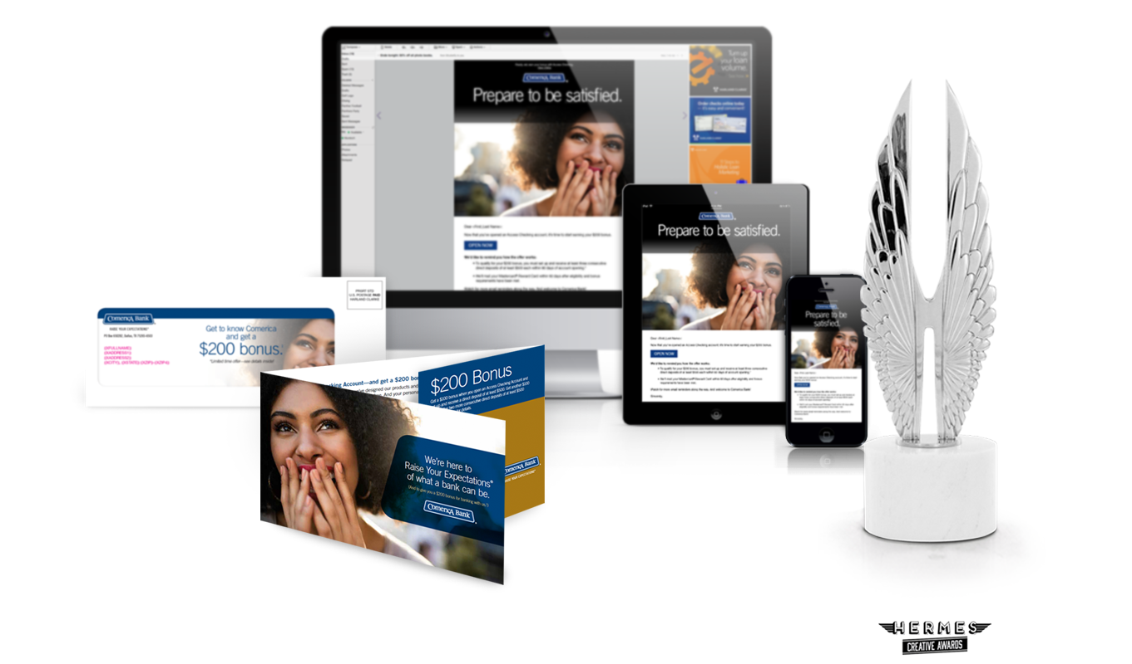
Award-Winning Creative Excellence
More than 400 creative awards in 5 years
Including:
Platinum Hermes Awards
Platinum MarCom Awards
Communicator Awards
Summit Creative Awards
APEX Awards
dotCOMM Awards
Graphic Design USA Awards
AVA Digital Awards

