Slide 1

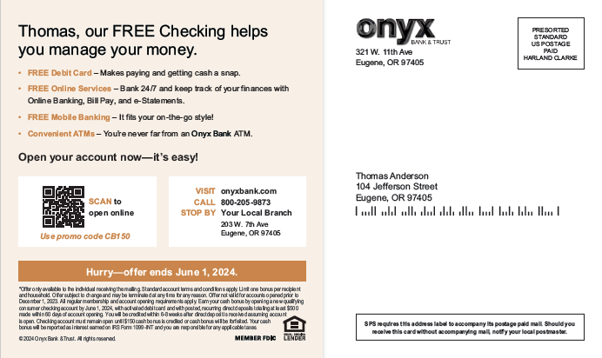




Multi Channel: Checking Engine
Self-Mailer
Shared Mail Postcard
Digital Display Banner
Connected TV

