Slide 1
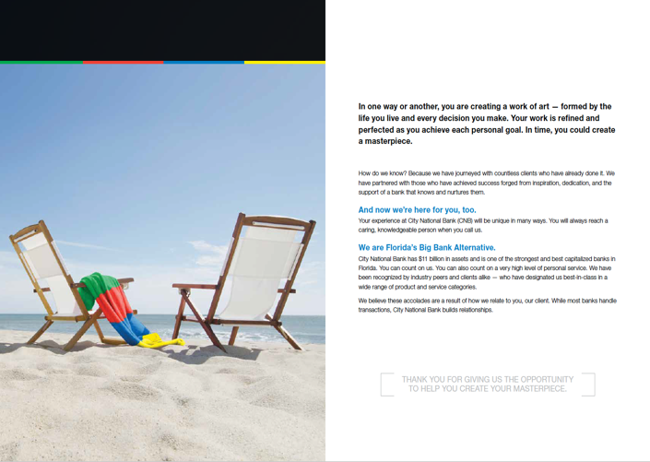
Mail: Merger & Acquisition
Business Ad
Product Brochure
Platinum MarCom Award
Merger & Acquisition Campaign
And Advertising Campaign

