Slide 1
Checking Engine
Creative Services

Slide 2
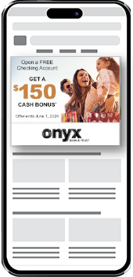
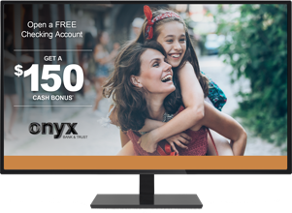
Multi-Channel Creative Development
Checking engine channels
Print
Video
Digital
Out Of Home
Audio
Display
Dynamic Mobile
VDP Postcard
Self-Mailer
Mega Sheet Insert
Connected TV
Banner
Display
Paid Social

Slide 3
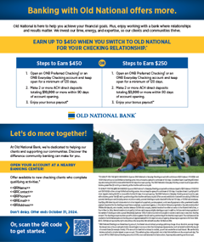
Choose from 3 Tiers of Service
Quick-to-Market (Q2M): Popular with small Banks and Credit Unions that do not have a particular brand. Development times are 80% shorter.
Brand Integration (BI): Common choice of FIs with a strong visual brand. Timing and skills required are between those of Q2M and Custom projects.
Custom: Common choice by large Banks. This tier utilizes all Creative resources. Requires more development time.

Slide 4
Choose from 3 Tiers of Service
Solutions are designed to meet the communication needs of all FIs—from local banks and credit unions to international FIs with a strong brand identity. Tiers vary in development timing and skills required:
 | Quick-to-Market | Brand Integration | Custom
Initial Proof | 2 days | 5 days | 10 days
Total Time in Creative* | 5 days | 9 days | 14 days
Total Time in Creative* - After initial development, most Client revision rounds for our Solutions are completed in one day. However, total time in development is dependent on how quickly designs can be reviewed by client-side approvers.

Slide 5
What Each Tier Includes
Quick-to-Market (Q2M):
Template Design ▪ Best Practices Copy
The template design is set; however, the Client can customize:
Colors
Images
Logos
Copy has been developed using proven industry best practices. Client can make minor copy adjustments or can provide their own copy using our copy templates.
Brand Integration (BI):
Custom Design ▪ Best Practices Copy
A designer will customize a layout that reflects the Client’s brand.
Each design will incorporate copy that has been developed using proven industry best practices, or the Client can provide their own. Since the design is customized, Client-provided copy is not restricted by our template.
Custom:
Custom Design ▪ Custom Copy
A designer and copywriter collaborate to customize a layout and copy that reflects the Client’s brand. In some cases, a Product Manager is engaged to organize product strategies and goals.
There are no template restrictions for design or copy.

Slide 6
What We Need To Begin
Solutions are designed with efficiency in mind. All Solutions include easy-to-use tools to collect needed information, quality-assured mechanicals, and defined processes.
Quick-to-Market (Q2M):
Signed Contract (PWO)
Client Completed Creative Service Request form
High-res logo, brand color formulation, signature files
Brand Integration (BI):
Signed Contract (PWO)
Client Completed Creative Service Request form
High-res logo, brand color formulation, signature files
Brand standards/Style guide (if available)
Examples of previous client ads
Custom:
Signed Contract (PWO)
Completed Creative Questionnaire
High-res logo, brand color formulation, signature files
Brand standards/Style guide (if available)
Examples of previous client ads
Client kickoff call invite (if needed)

Slide 7
Multi-Channel Simplified Available in all tiers of service
Print
1
Creative Services focuses on creation of all channel components
Creates a cohesive campaign
Single communication contact point
Simple content approval process
2
Implementation Teams focus on pre-production of their channel’s components
Ensures production excellence
Faster implementation
Targets expertise
Email
Digital
Video

Slide 8
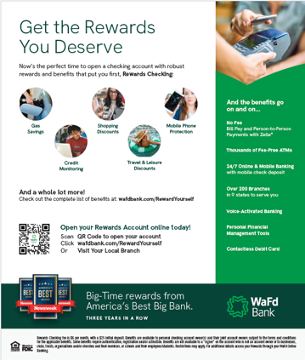
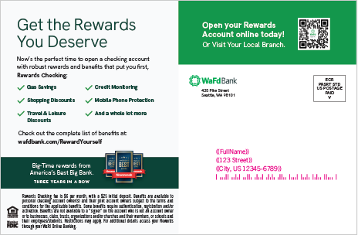
WaFed Custom Creative
Postcard
Self-Mailer

Slide 9
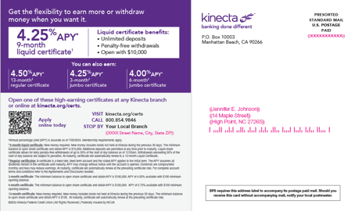
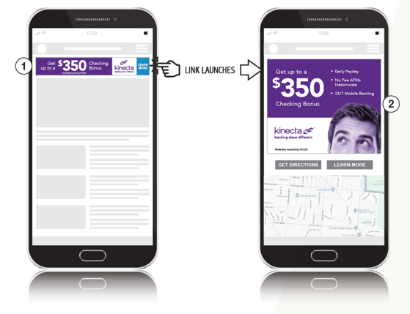
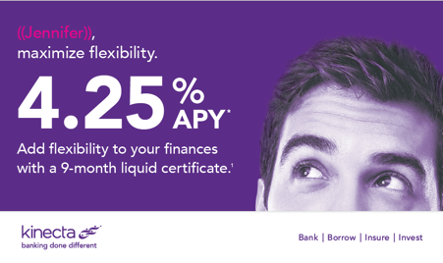
Kinecta Brand Integration Creative
Dynamic Mobile
Postcard
Self-Mailer

Slide 10
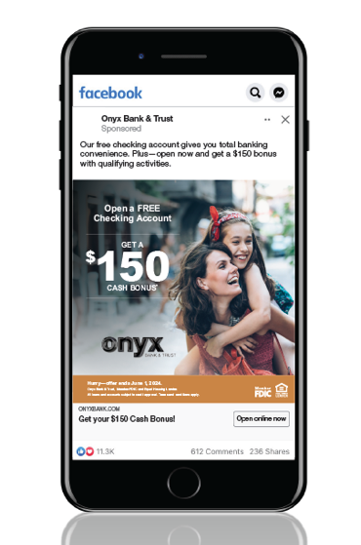
Onyx Quick To Market Creative
Digital Display
Paid Social

